Slide 1
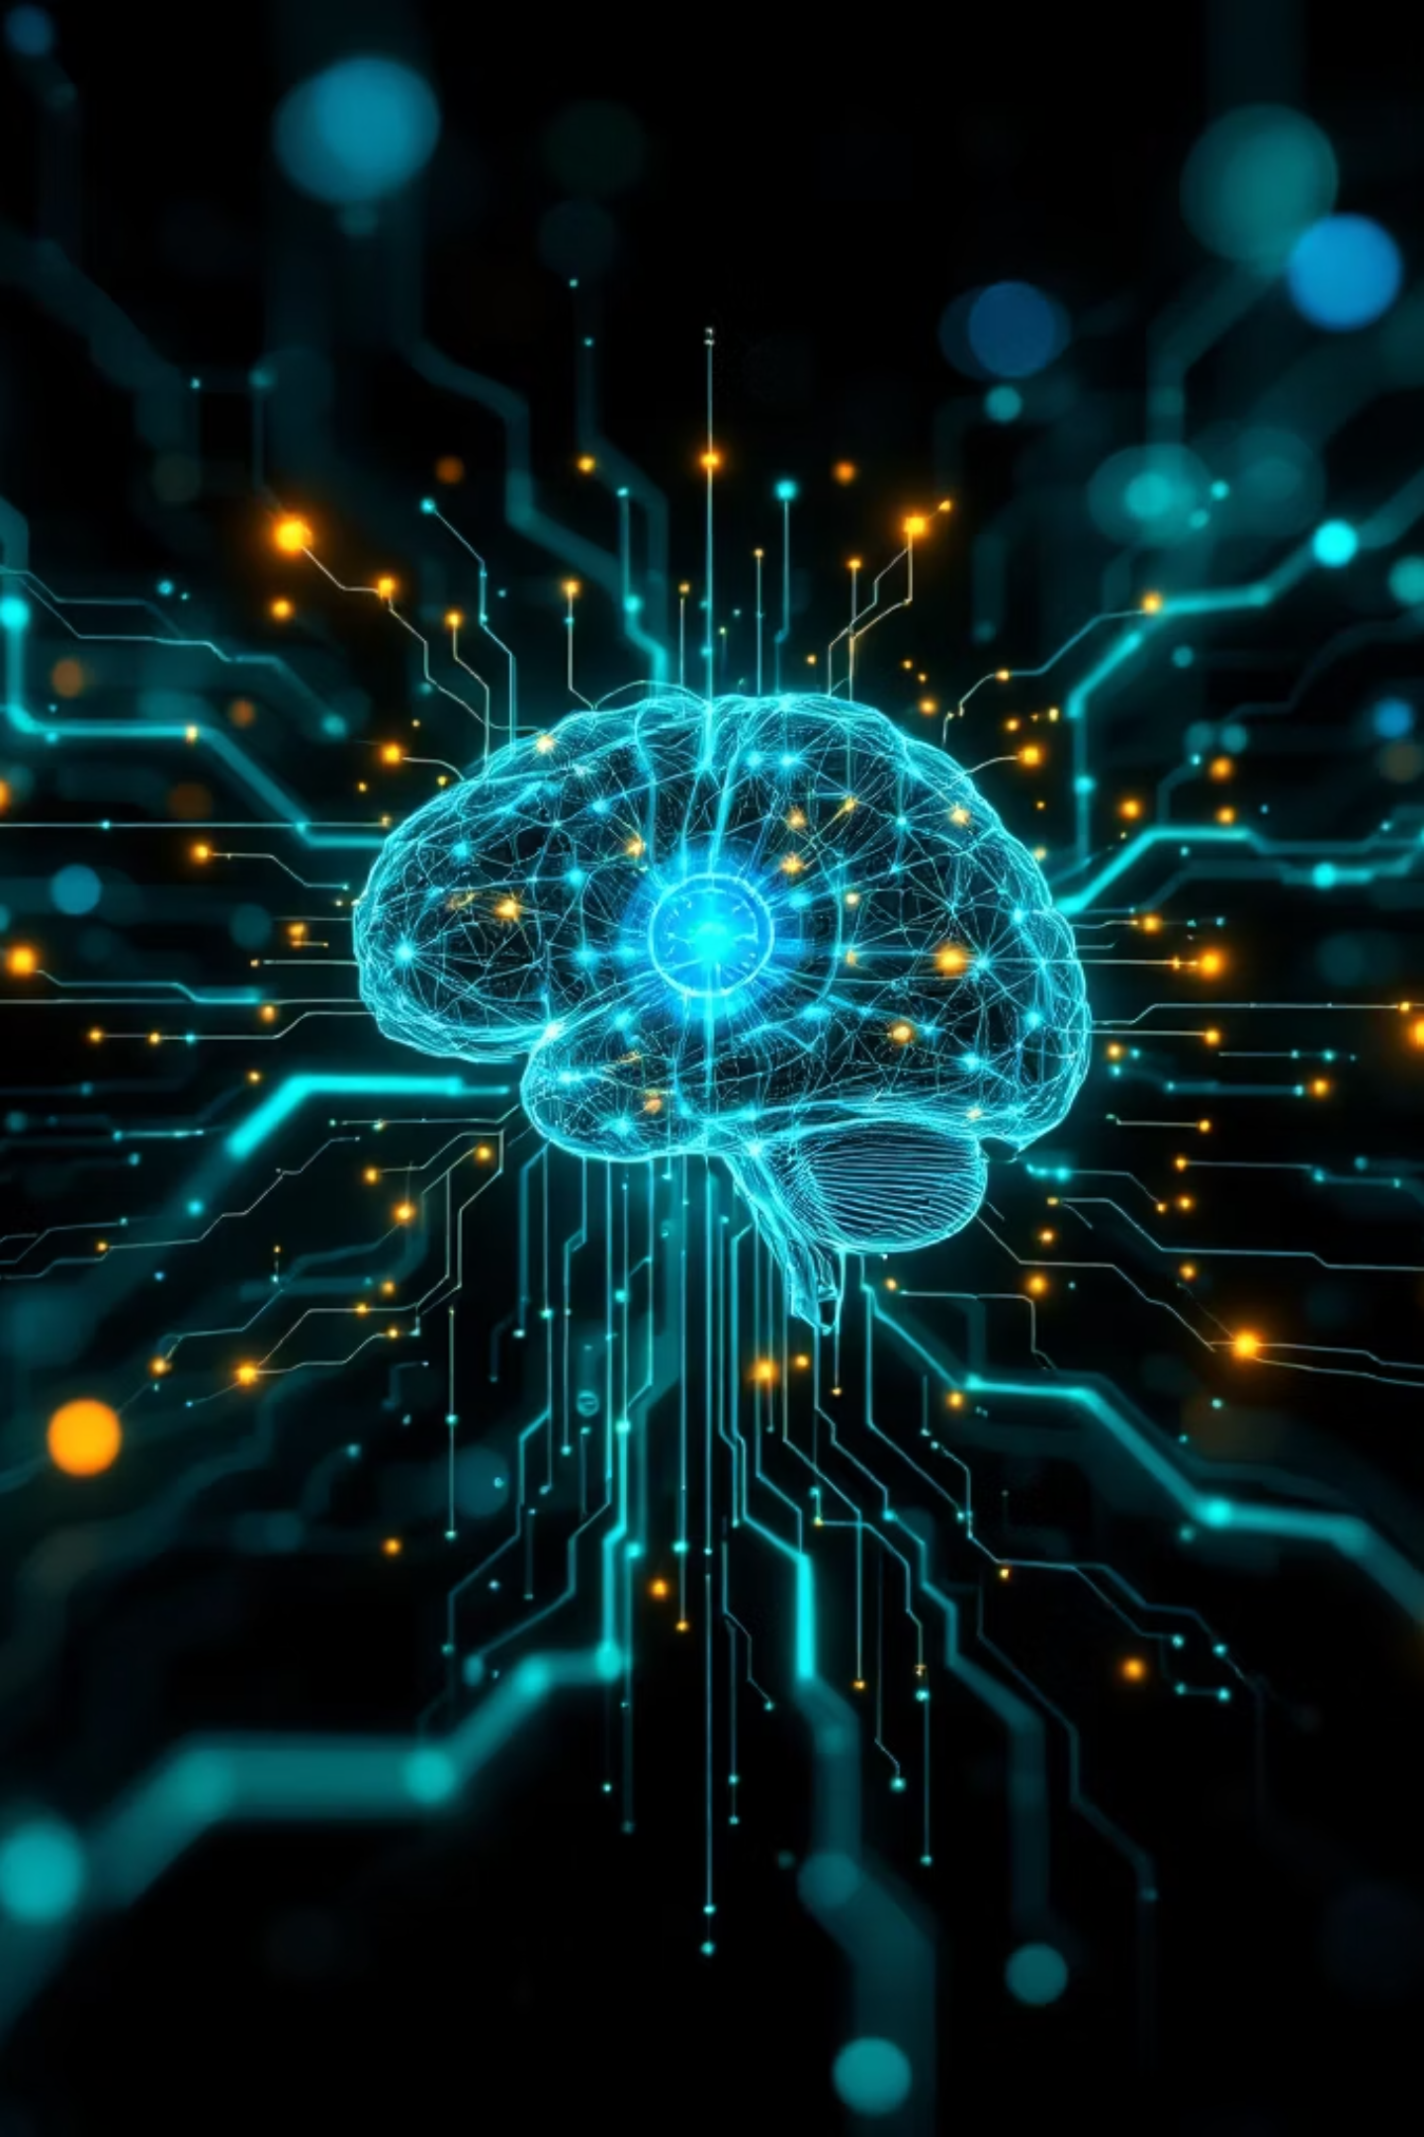
AI-Powered Smart Learning Platform
Adaptive Multi-AI Learning System
Team: S. Gokula Kumaran, R. Rokash, J. Johnson Joel, R. Rathiesh
Ramco Institute of Technology

Slide 2

Unified Learning Experience
Multi-AI Platform
Adaptive Learning
Cloud + local AI models
Level-based (School/UG/PG)
Multi-Domain
Complete System
All subjects in one place
Learning + evaluation + feedback
Replace multiple apps with one intelligent learning ecosystem

Slide 3
Core Features
Interactive Learning Modes
Chat Mode
Voice Mode
Continuous AI interaction
Ask questions naturally
Document Upload
Study Modules
Analyze study materials
Structured content generation

Slide 4
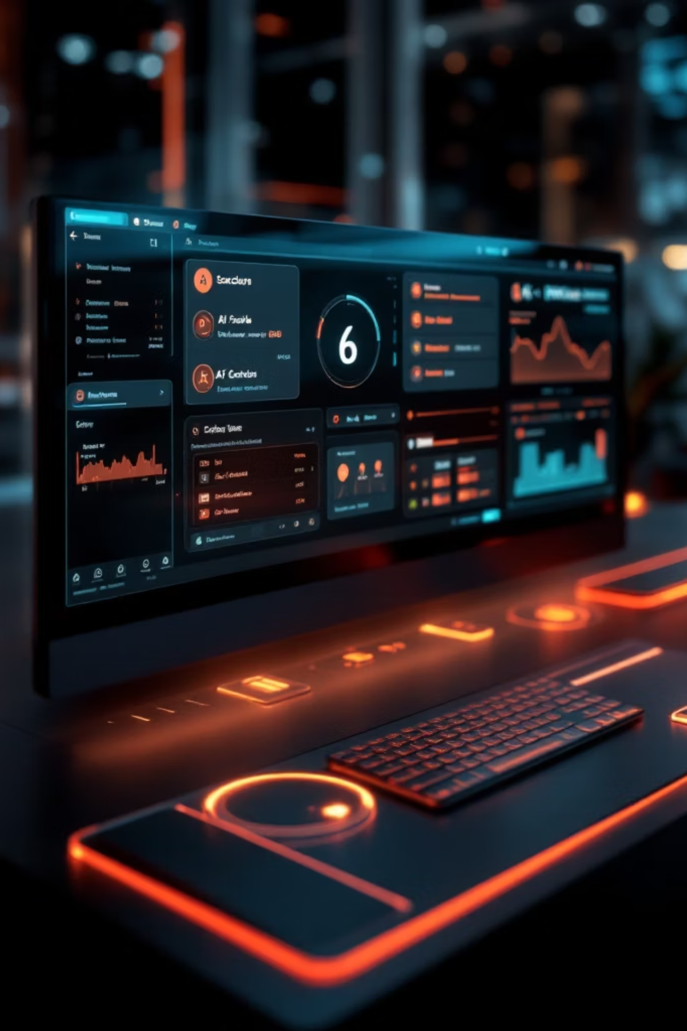
Dynamic Assessment System
01
Quiz Generation
Dynamic questions based on level
02
AI Evaluation
Intelligent scoring system
03
Detailed Feedback
Performance insights
04
Roadmap
Step-by-step learning plan

Slide 5


Intelligent Tutoring Behavior
Adaptive Suggestions
Based on performance
Multi-Session Chat
Context-aware conversations
Personalized Responses
Tailored to your needs
Not just a chatbot → Intelligent learning system

Slide 6

Analytics Dashboard
Data-Driven Learning Insights
Performance Tracking
Real-time progress monitoring
Topic-Wise Analysis
Subject-specific breakdown
Weak Area Detection
Identify improvement areas
Progress Over Time
Long-term performance trends

Slide 7
Future Roadmap
Database Integration
Long-term tracking system
Multi-User Login
Individual accounts
Mobile App
Learning on the go
Multi-Language
Global accessibility
LMS Integration
Platform compatibility
Advanced AI
Deeper personalization

Slide 8
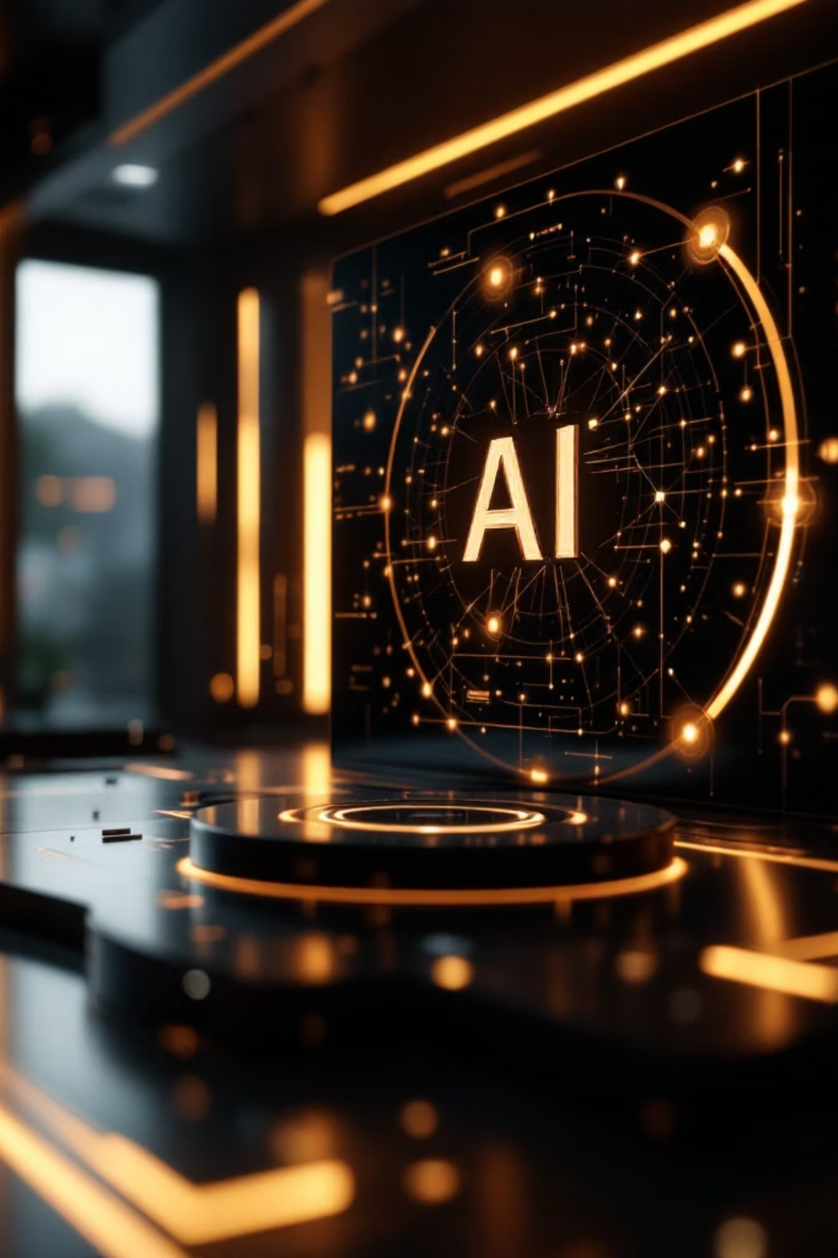
Learn Smarter with AI
All-in-One Platform
Time Efficient
Single solution for diverse learning needs
Reduces app switching and improves productivity
Personalized
Adaptive experience across all domains
Empowering Learning with AI

